Slide 1
Weather History (Data Analysis)
Presented By:- pusp kumar vyas

Slide 2
Introduction
The Weather History is the climate change data of Hungary area, between 2006 and 2016. The Weather History includes 10+ factors and approx 10000 observations . Our main job is to explore the factors which have an impact on the Temperature in Hungary.

Slide 3
Factors which can have impact on Temperature
Time
Summary
Precipitate Type
Apparent Temperature
Humidity
Wind Speed
Wind Bearing
Visibility
Loud Cover
Pressure
?

Slide 4
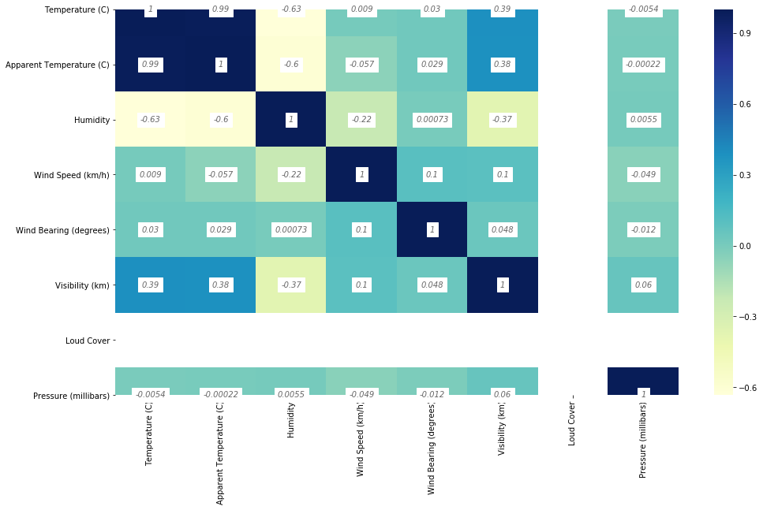
Correlation Between Factors

Slide 5
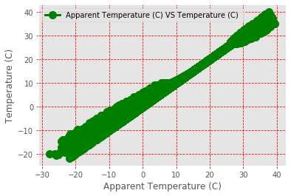
Apparent Temperature (C) VS Temperature (C)
Correlation between Apparent Temperature and
Temperature is 0.992629

Slide 6
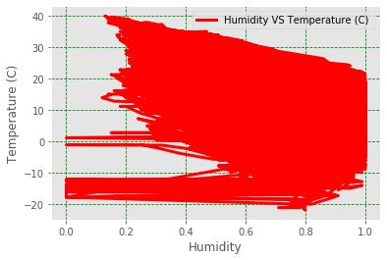
Humidity VS Temperature (C)
Correlation between Humidity and Temperature is 0.632255

Slide 7
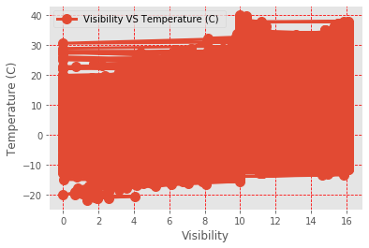
Visibility(Km) VS Temperature (C)
Correlation between Visibility(Km) and Temperature is 0.392847

Slide 8
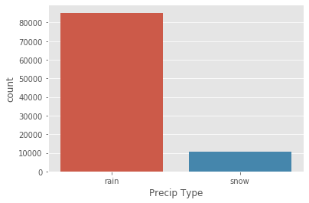
precipitate Type
Approx in 90% observations, Weather of Hungary is Rainy .

Slide 9
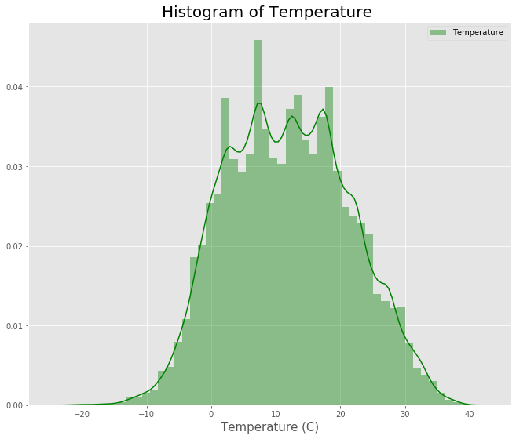
Temperature(c)
Approx in 90% times Temperature lays between
-10(c) t0 30(c).
Approx 70% times Temperature lays between 0(c) to 20(c).

Slide 10
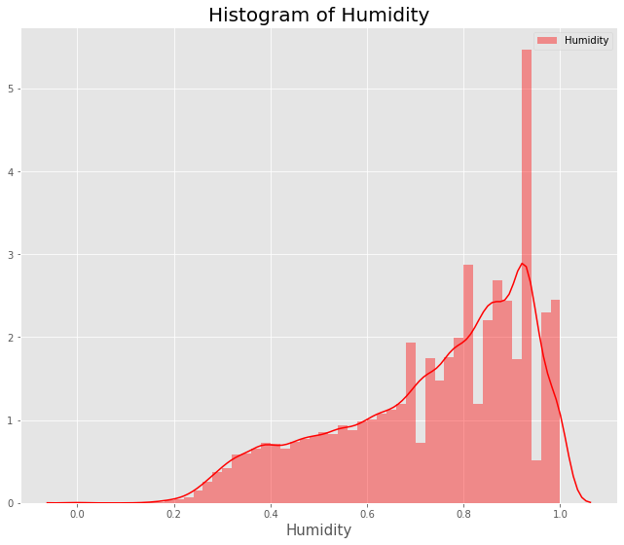
Humidity
Approx in 90% times Humidity lays between
0.4 t0 1.0.
Approx 70% times Humidity lays between 0.6 to 1.0.

Slide 11
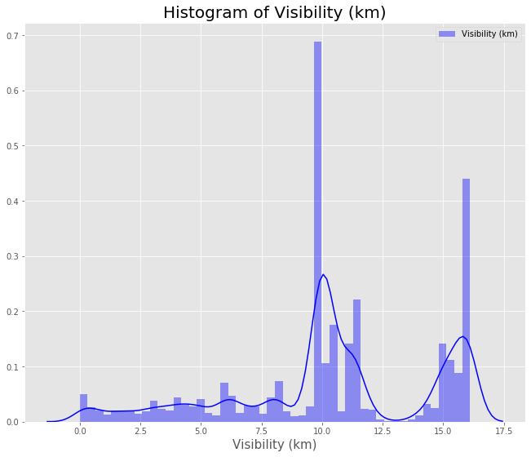
Visibility (km)
Approx in 90% times Humidity lays between
7.5 km t0 16 km.

Slide 12
Significant Factors which can impact Temperature
Precipitate Type
Apparent Temperature
Humidity
Visibility ?????? (correlation is Less)

Slide 13
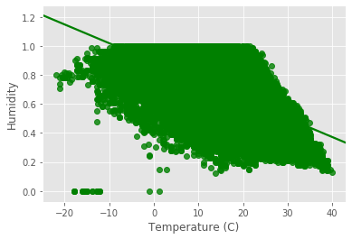
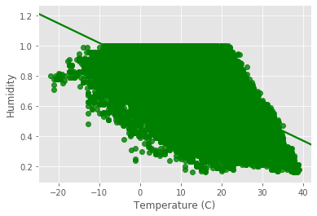
Cleaning outliers and Replacing Missing Values
Before After
Omitted 38 observations from 96453 Observations and In precipitate Type NAN value s has been Replaced by most frequent Value.

Slide 14
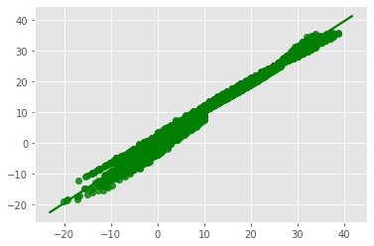
After Training Model from Regression Technique
There is difference in actual and predicted value of the Temperature .

Slide 15
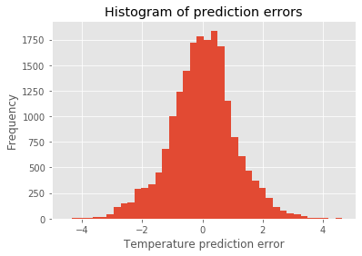
Temperature Prediction error
Approx 80% Temperature prediction Error lays between -1 (c) to 1(c).

Slide 16
Conclusion
Precipitate Type(Rain)
Apparent Temperature
Humidity
All of the above Factors are most significant for Temperature change in Hungary.

Slide 17
Thank You !

